Slide 1
Level Home
PRODUCT DESIGN
DESIGN LANGUAGE SYSTEM
Content strategy
The contents of this document are the sole and confidential property of Material and may not be reproduced or distributed without the express written permission of Material+

Slide 2
Opening the door to possibilities
challenge
Prior to our engagement, Level merged with Dwelo, a leader in smart home solutions—primarily for the apartment and rental industry—to create Level M. The acquisition allowed Level to leverage Dwelo’s powerful technology, but left the partnership visually undefined. Material+ was tasked with designing an elevated, Level-branded web experience on top of an enhanced technology platform for their multi-family staff experience.
approach
To unify Dwelo’s technology with Level’s clean, streamlined UI, Material+ developed an in-depth design language system—supported by UX writing and strategy—and worked closely with Level’s product team to design a user-friendly experience that both removed barriers for staff and surfaced the right information at the right time, providing customized, easy, and secure access to staff, residents, visitors, and prospects.
Solution
An elevated brand expression and web application for Level’s multi-dwelling unit (MDU) staff experience.

Slide 3
Defining the brand for web
Level
Crafted specifically for web, the new design system, called Nebula, builds on top of Level’s existing brand foundation.
Combining this foundational system with a theme editor feature, properties could visually boast Level's brand credibility while maintaining a sense of personal identity.

Slide 4
Mapping the journey
Level
To create a seamless experience within a multi-family community, we needed to first understand what kind of access was needed, where it was needed, and when—for multiple end users. We also needed to account for how that access was communicated to each audience across app, SMS, and email.

Slide 5
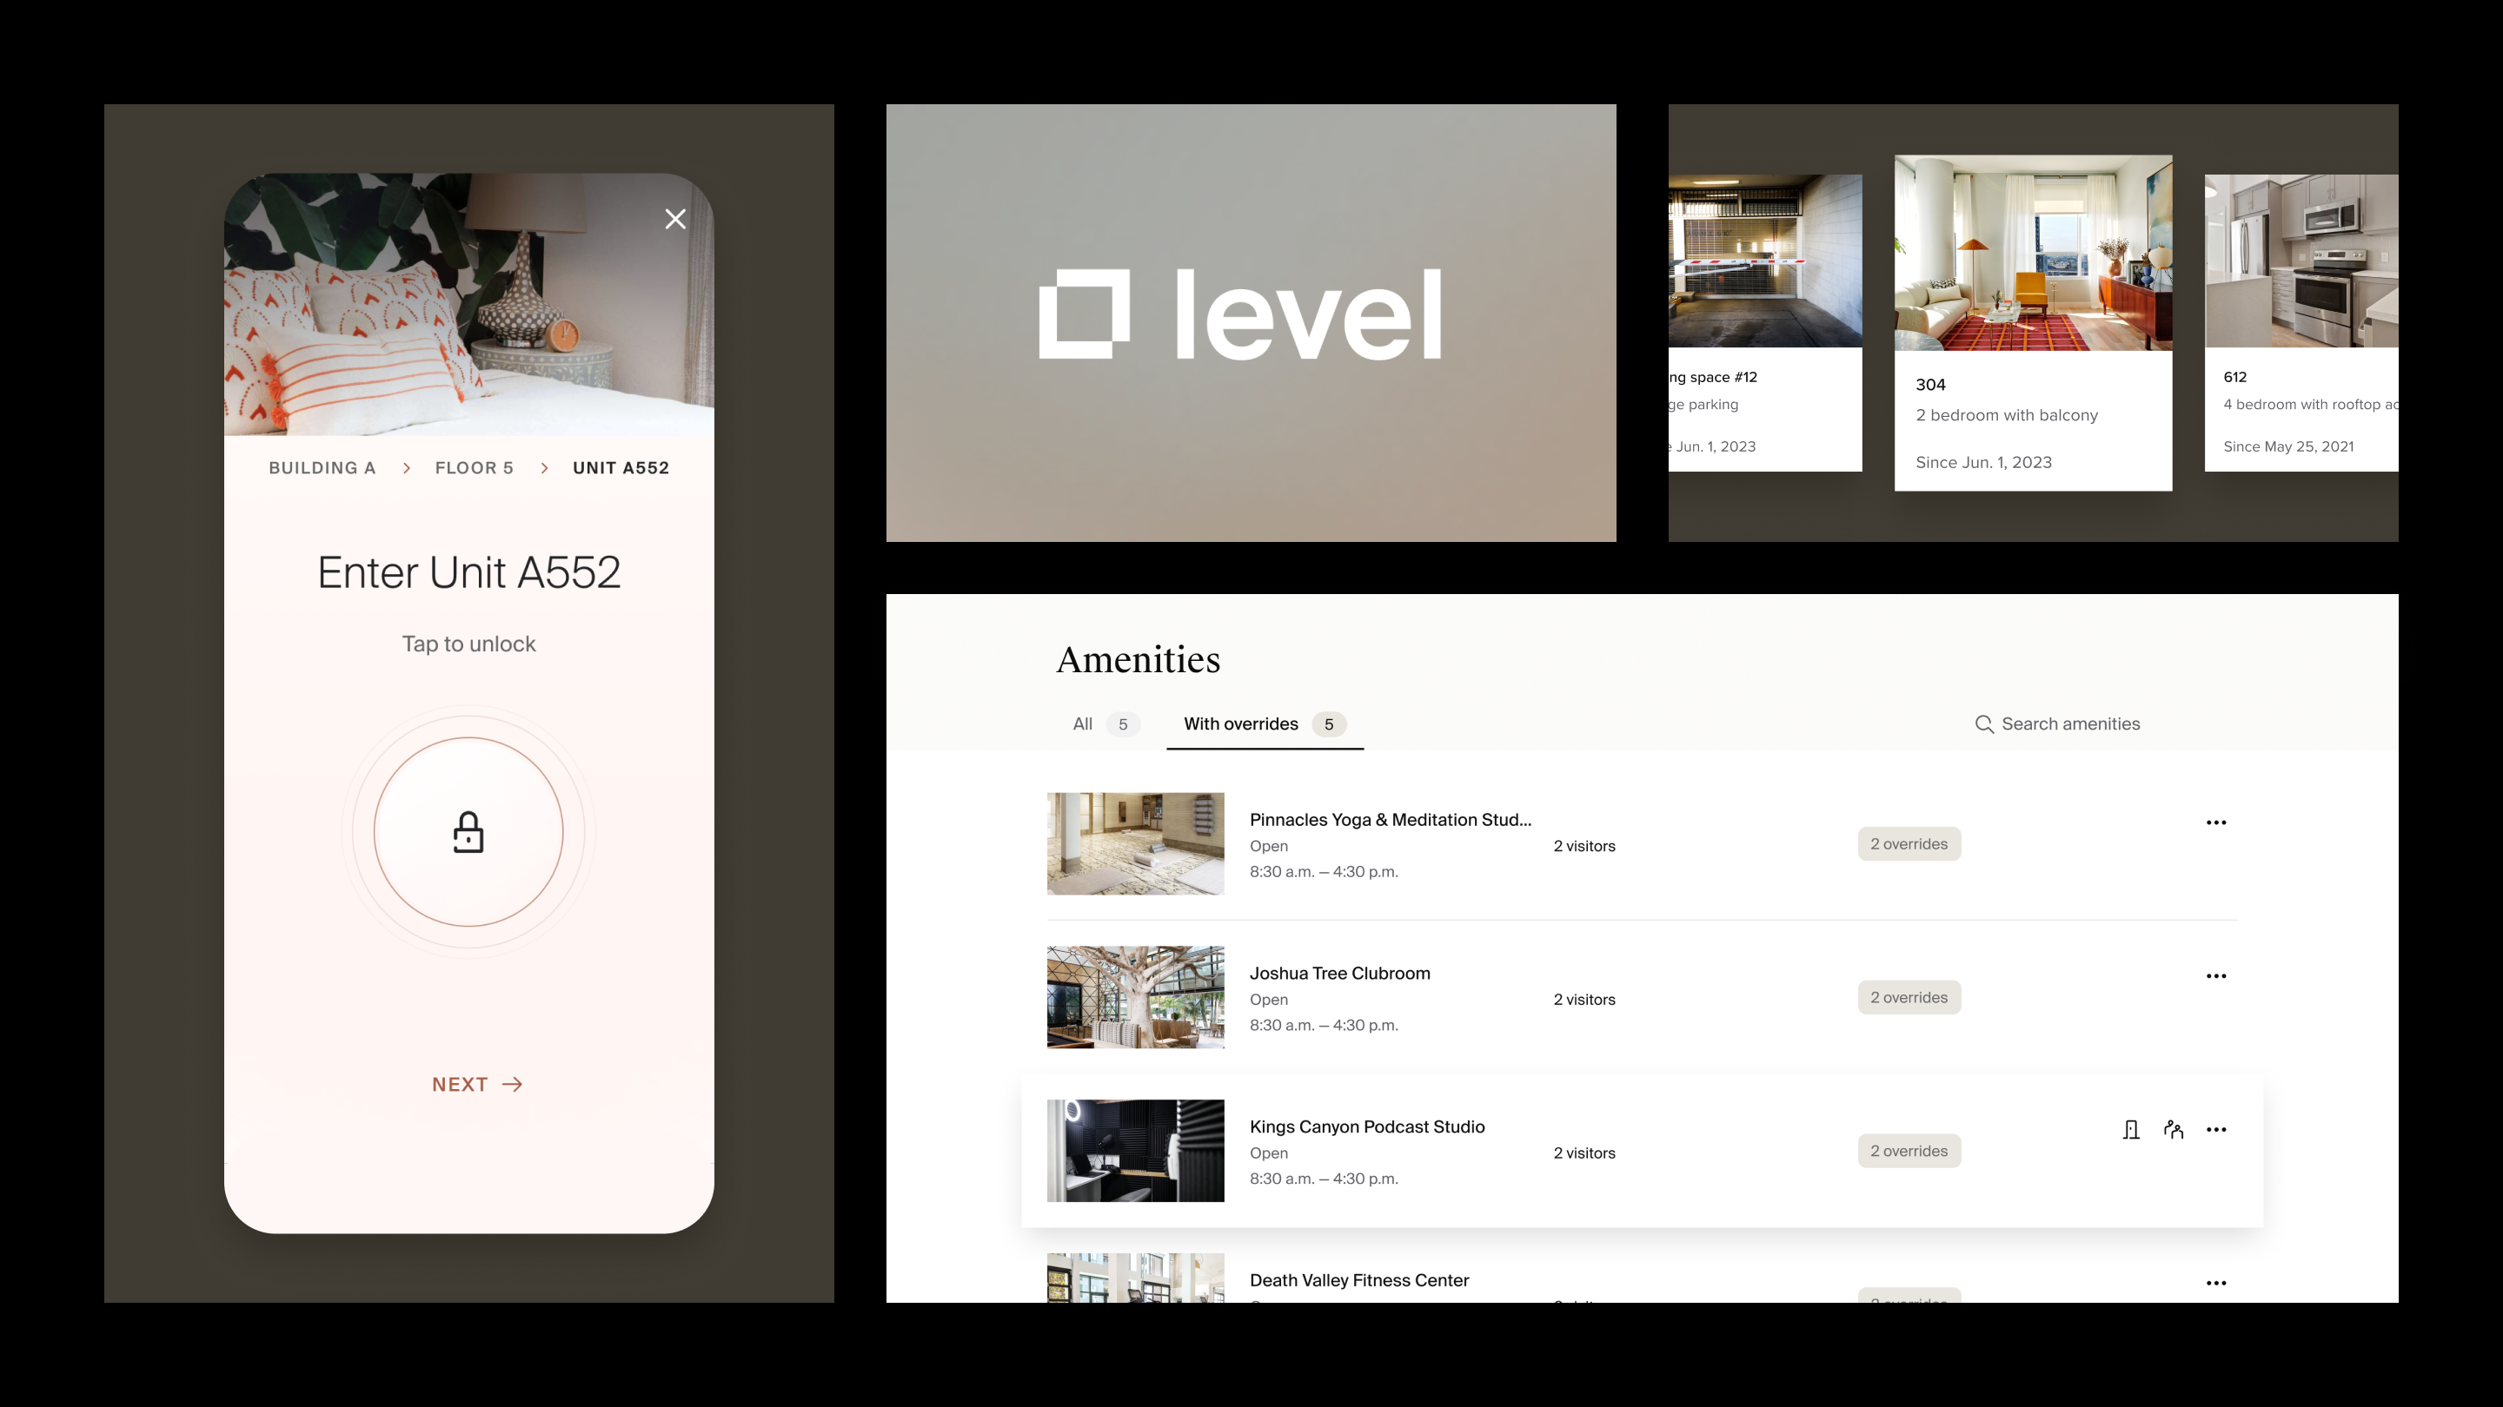
Case study
Level

Slide 6
Configurable controls and real-time data
Level
Surfacing the right information and actions without overwhelming the user was key to an intuitive UI experience. Within the app, users can configure staff permissions, control access status at the building, unit, and entrance level, and view extensive, real-time data on demand.

Slide 7
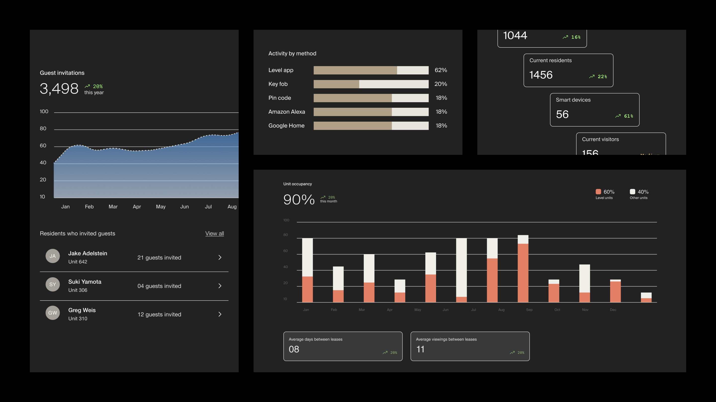
Level

Slide 8
Enhanced communication assets
LEVEL
Material+ developed templates and content for email and SMS to communicate access details before, during, and after a visit. From these emails, users could open the Level app and seamlessly connect their access permissions while touring, visiting, or moving into a property.

Slide 10
Visitor access

Slide 11
Results
PRESIDIO
$100K
$1.74M
$5,880
Average increases in net operating income by implementing smart tech*
Boost in property value at the average 250-unit community*
Yearly savings in rekeying expenses for average 250-unit community*
"We are where we are today not because we were the loudest or the largest, but because we quietly worked to address the unique challenges facing owners and operators when others were merely repurposing and marketing technologies designed for single-family homes."
Mike Rovito
CEO
Ambient, formerly Level M
*Data from Ambient Insights
Notes:
improvement in overall SEO ranking

